Slide 1
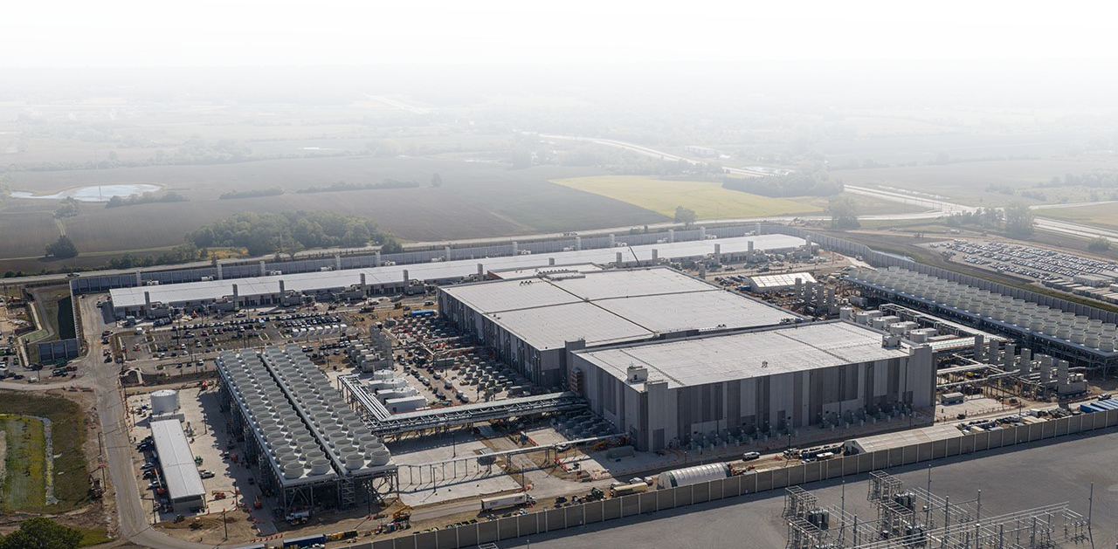
Wisconsin Data Centers in 2026
Anna Haensch, PhD
Research Associate Professor, Data Science Institute
Associate Director, Digital Scholarship Hub
July 20, 2026
Wisconsin Association of Assessing Officers

Slide 2
Data Center Basics

Slide 3
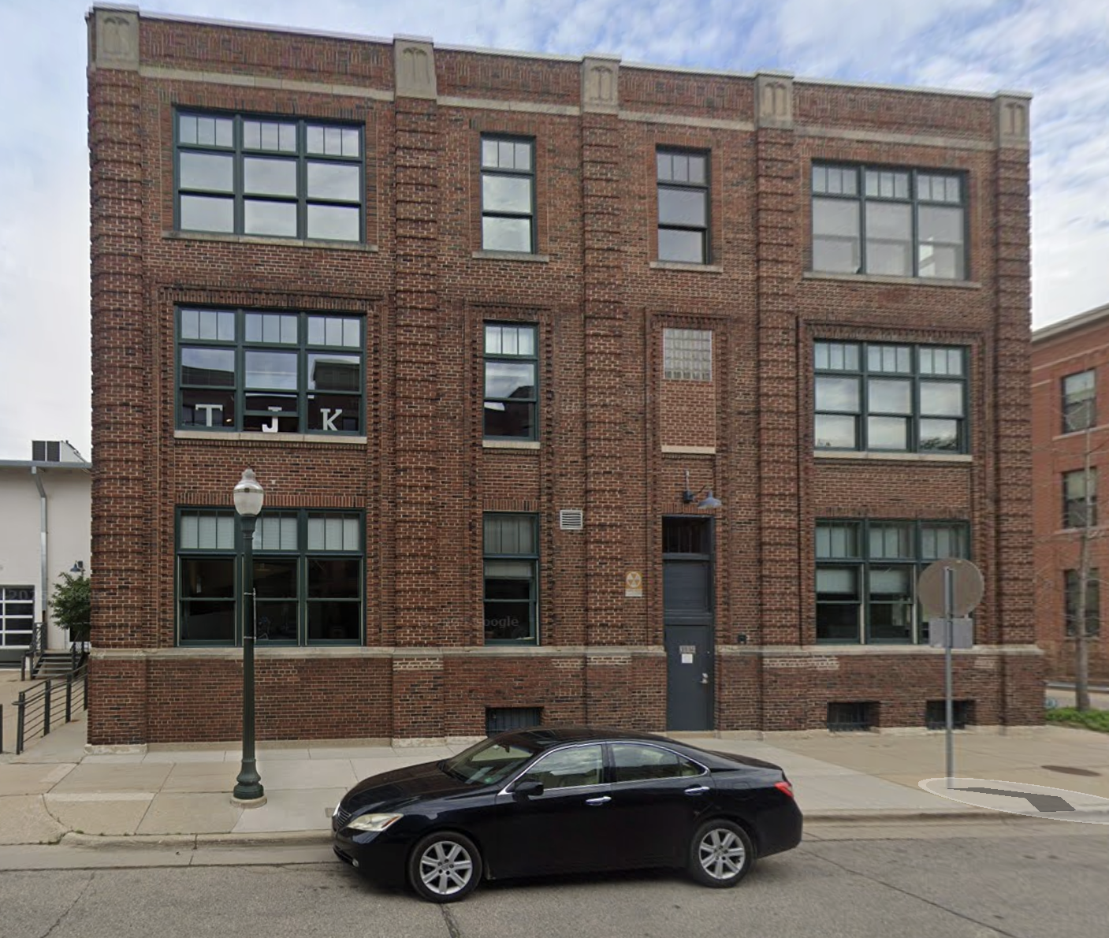
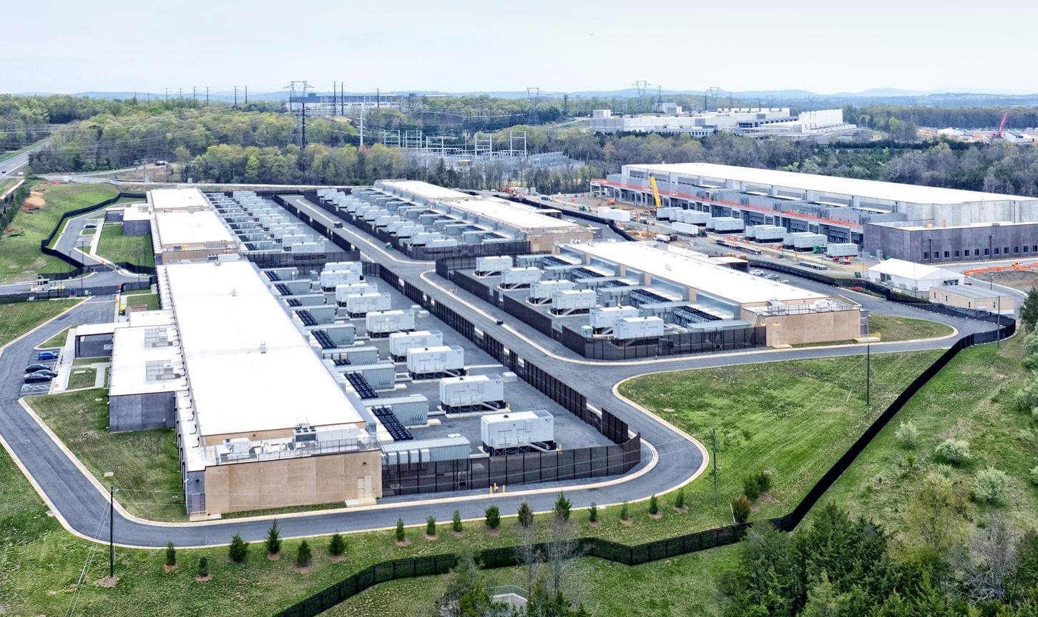
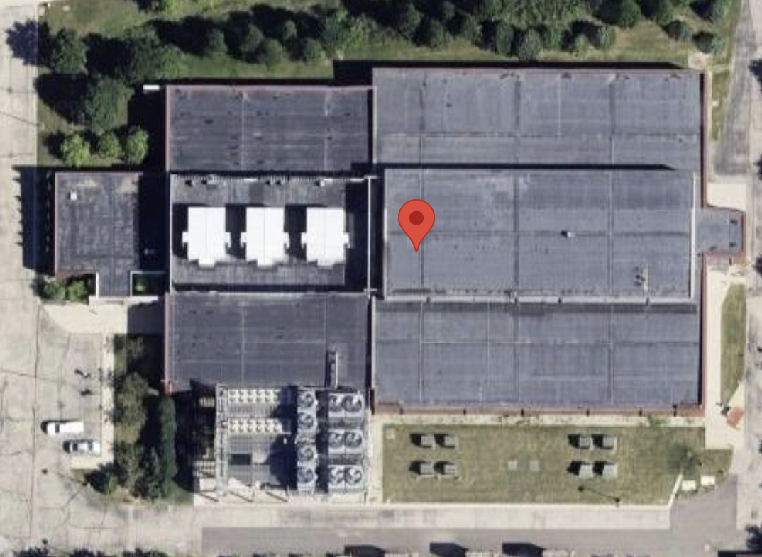
What is a data center?
A data center is a collection of computers in a building serving up data, computation, and other cloud resources for people offsite.
Hyperscale Data Centers
Colocation Facilities
Port Washington Data Center Drive-By

Slide 4
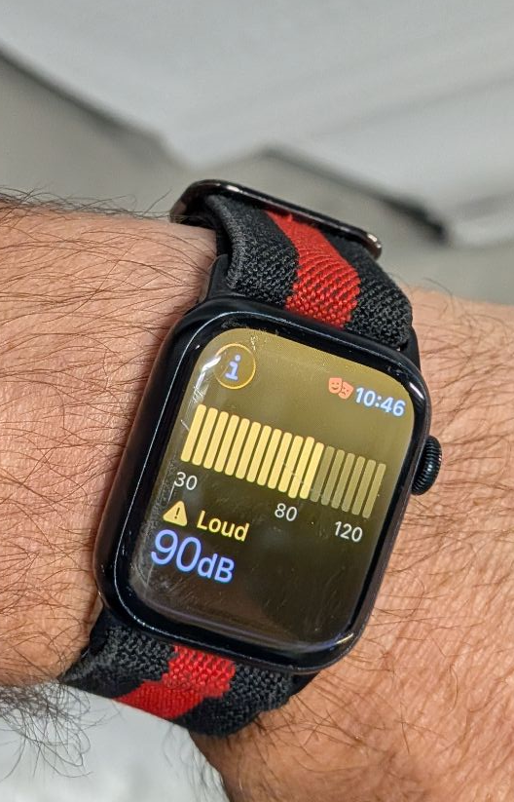
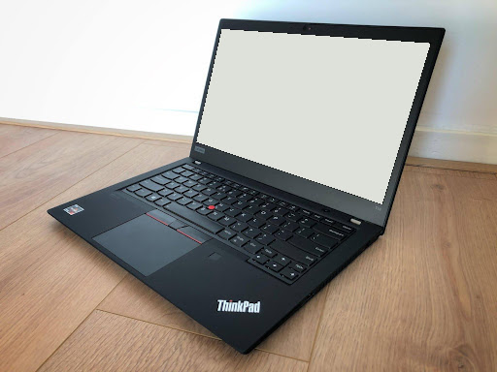

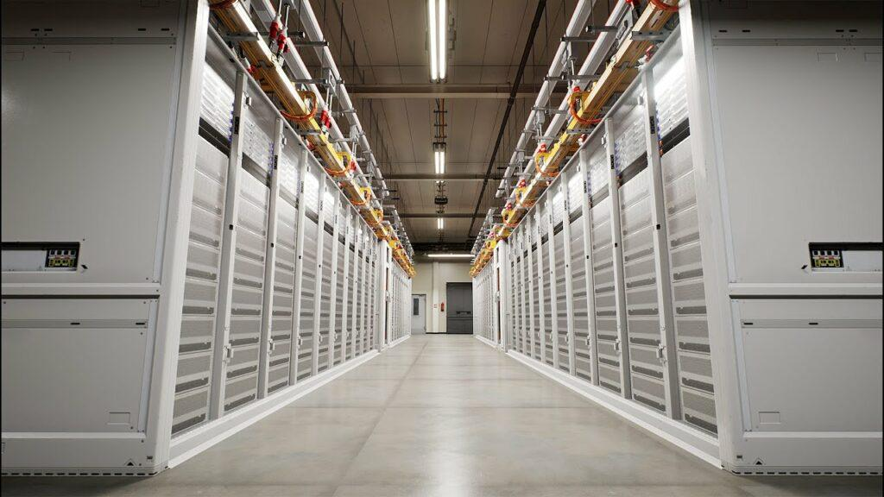
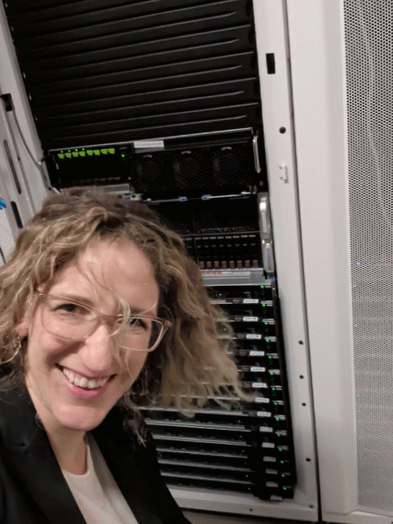
The Data Center AI Connection
Trained models stored at data centers.
Inference results are returned through API or cloud services.
Current data center capacity can’t accommodate the forecast AI need, this is driving massive growth.

Slide 5


The Brains of the Data Center
The Central Processing Unit (CPU)
is the generalized brain of the computer that’s pretty good at most things.
The Graphical Processing Unit (GPU) is a super-specialized brain that’s good at computing, geometry, and linear algebra.
A single Nvidia Blackwell GPU is rated at 700 to 1,200 W. Between a refrigerator and a window AC unit.
Nvidia owns 90% of the server GPU marketshare.
Nvidia chips are currently made in Taiwan by Taiwan Semiconductor Manufacturing Company.
A typical CPU is rated at 125 - 190 W. Slightly less than a rice cooker.
AMD and Intel own ~100% of server CPU marketshare.*
* For now.

Slide 6
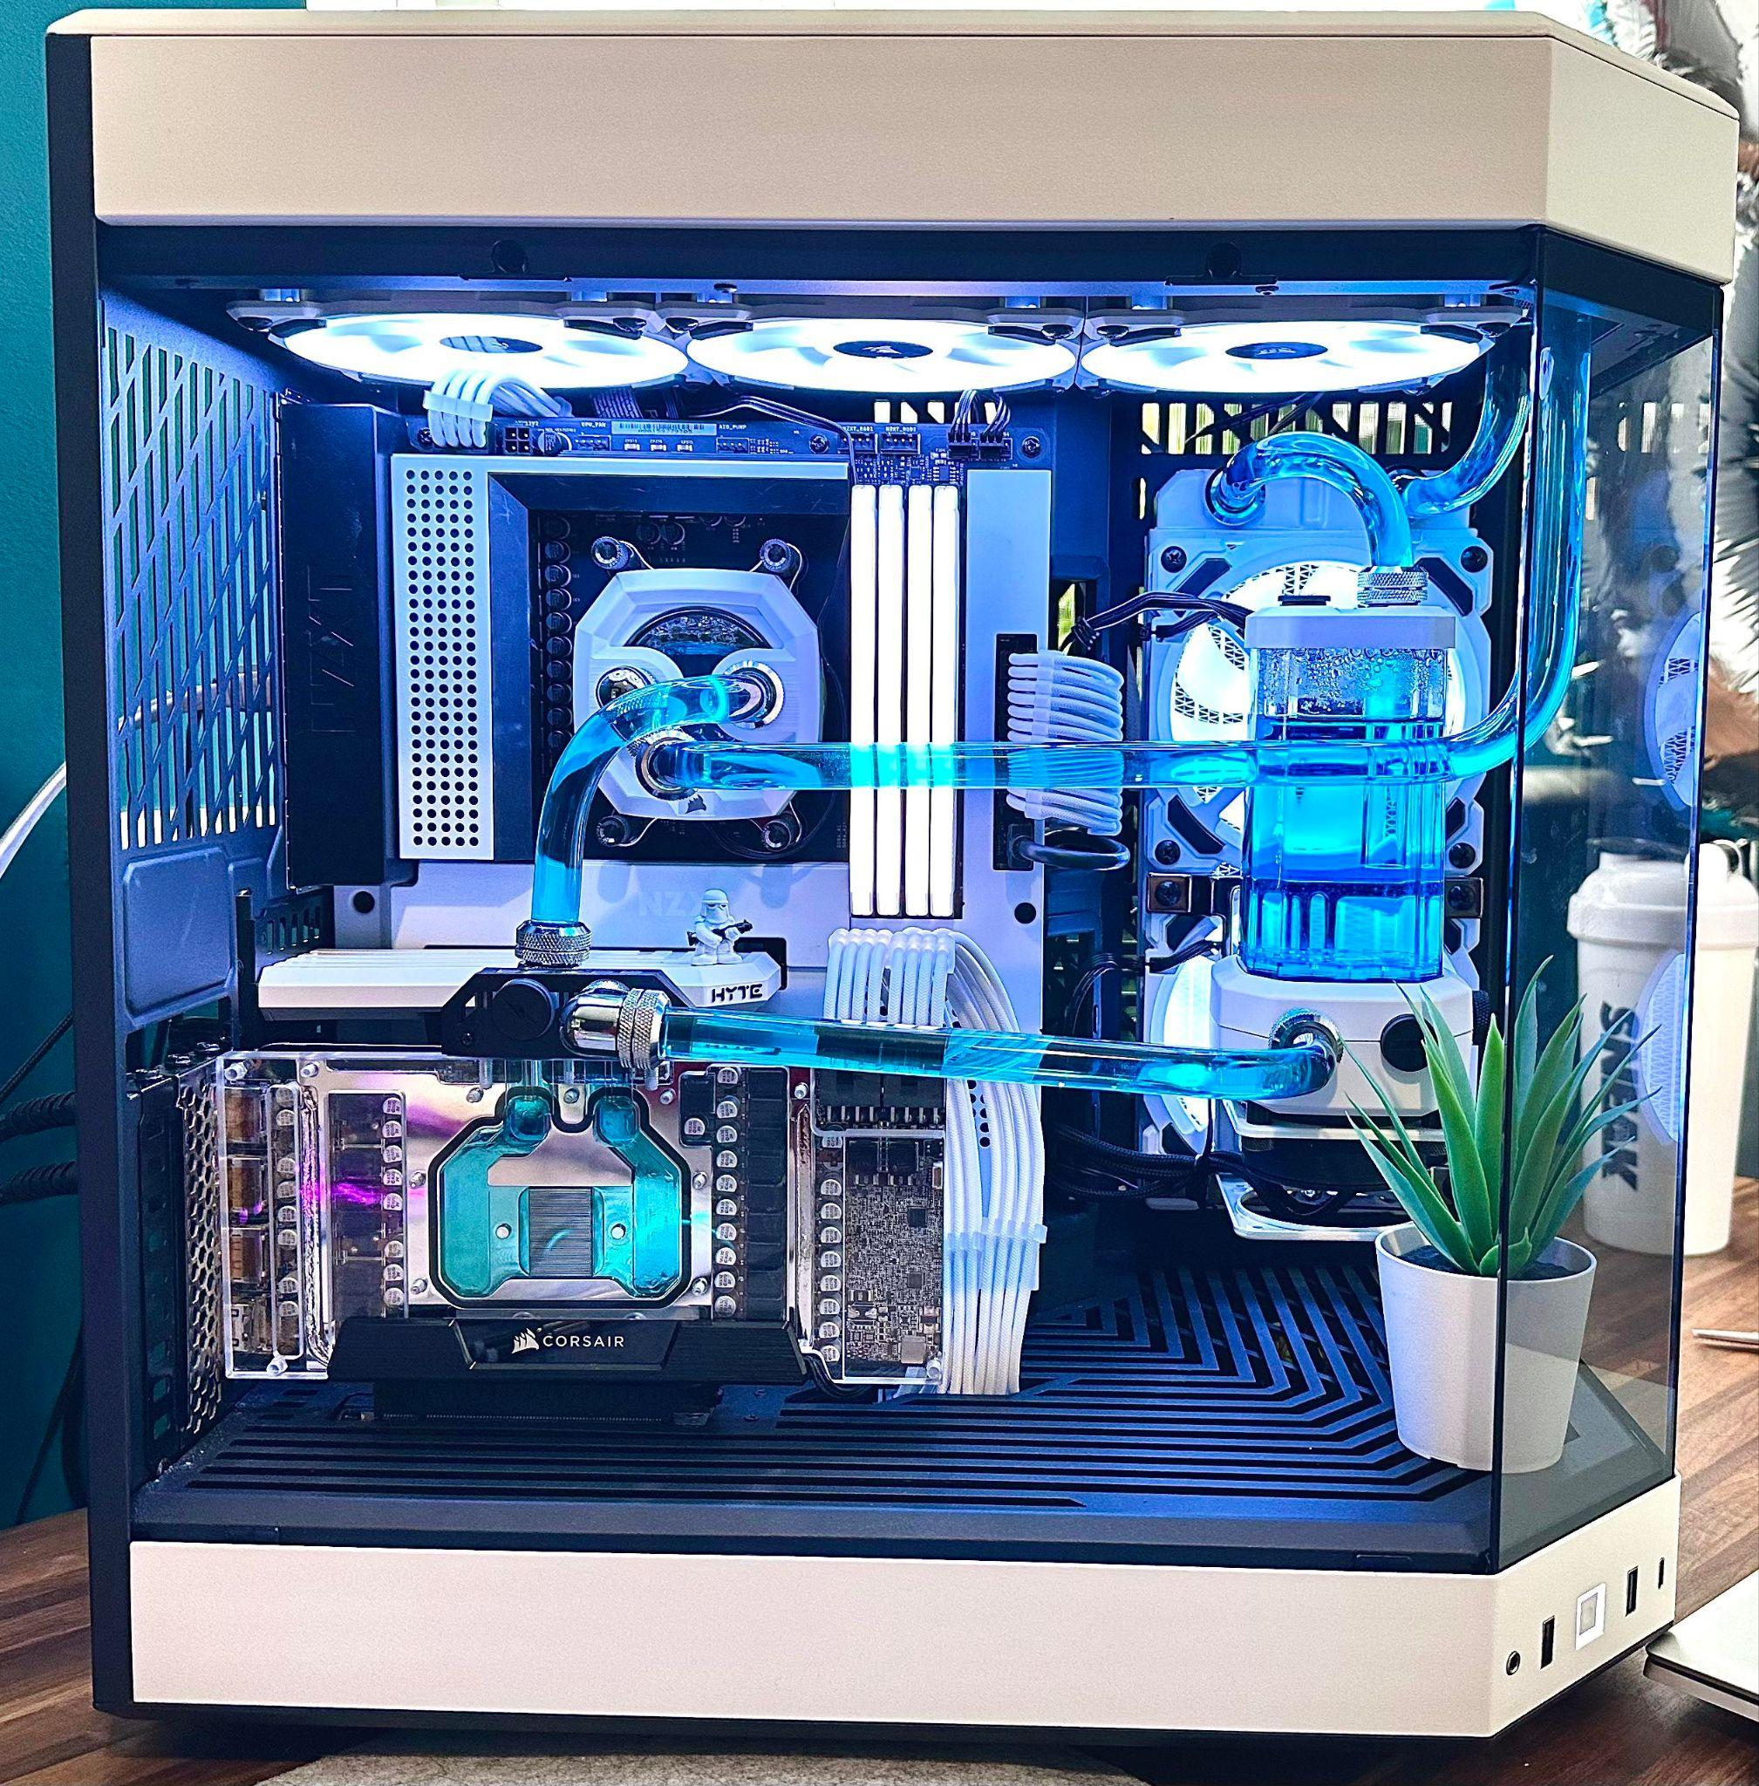
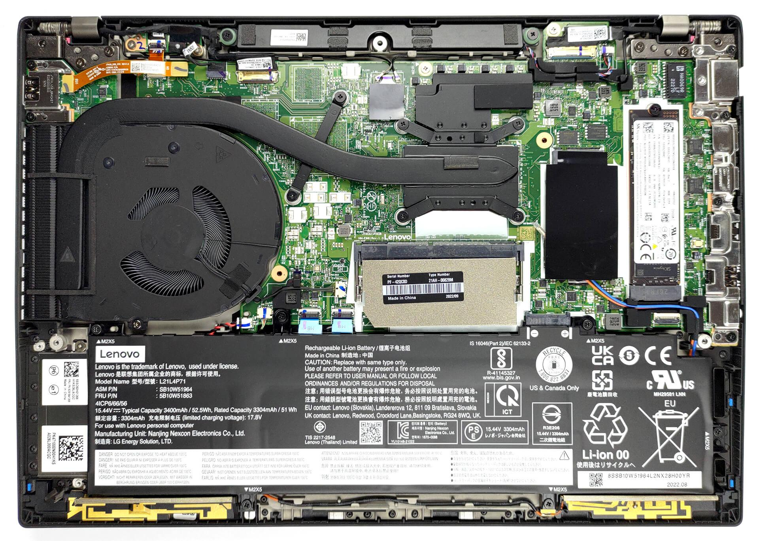
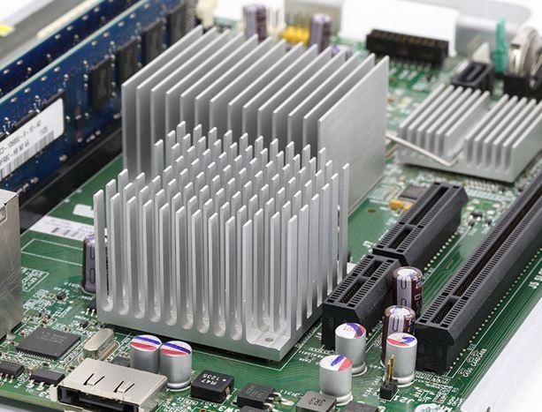
Computing Generates Heat
Cooling systems of all sizes include fans, heat sinks, and water loops, these also take energy to operate.

Slide 7
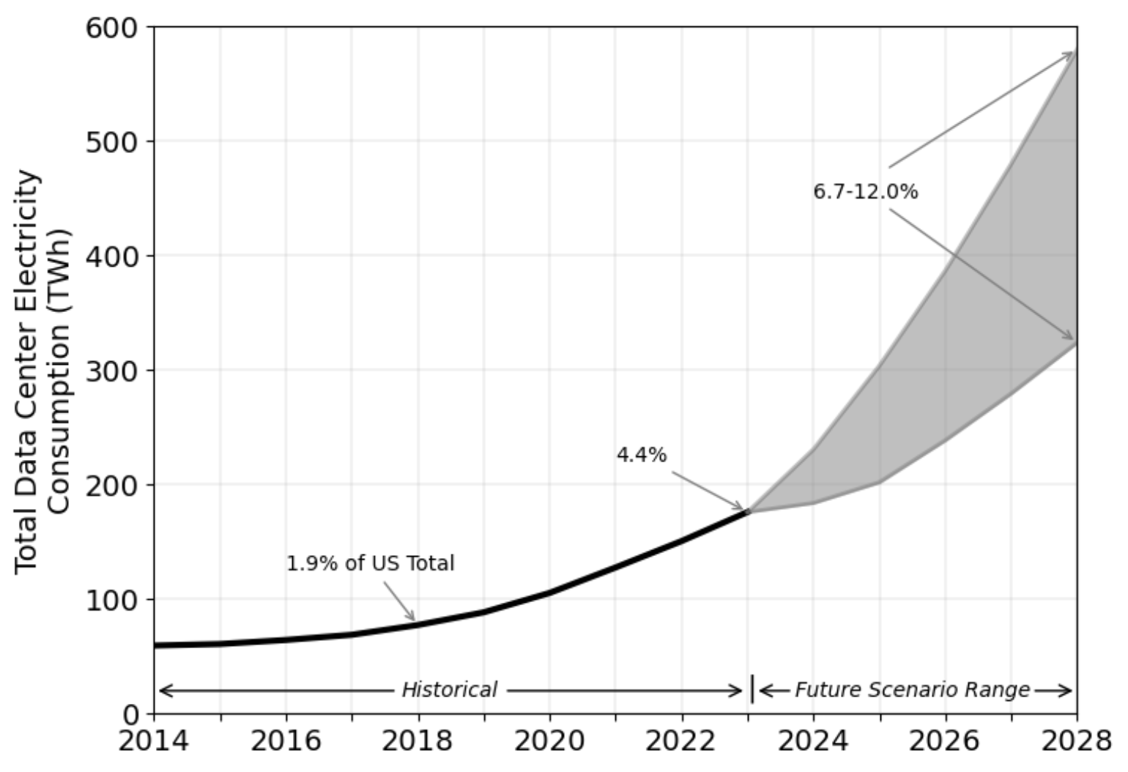
Data Centers are Growing in the US
184 TWh in 2024
Shehabi et al (2025). 2024 United States Data Center Energy Usage Report; International Energy Agency (2025) Energy and AI.

Slide 8
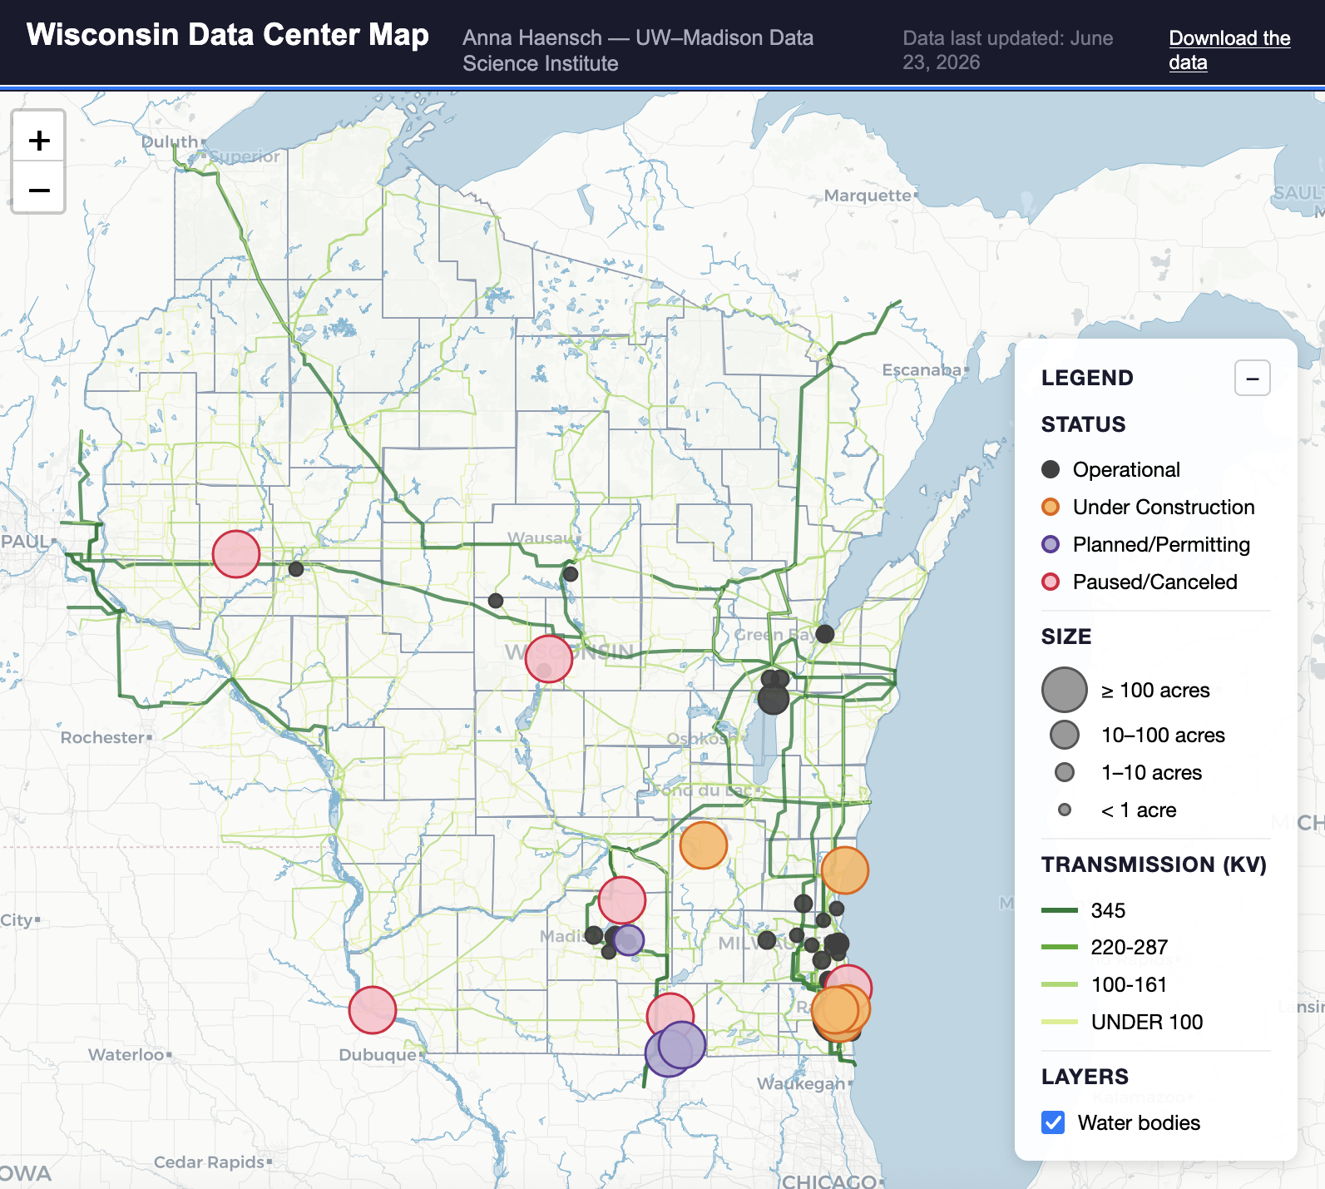
Current Data Center Footprint in Wisconsin
Beaver Dam - Meta’s 700,000 square foot AI-workload campus.
Port Washington - Vantage Data Centers’ “Stargate” data center developed in partnership with OpenAI and Oracle.
Mt. Pleasant - Microsoft’s multi-site campus in Mount Pleasant; Phase 1 operational as of June 23, 2026.
Haensch (2026), Wisconsin Data Center Map.

Slide 9
The Wisconsin Data Center Discourse
 | Benefit | Risk
Jobs | Create lots of high-tech jobs and high paying jobs. | Job creation is minimal, and mostly limited to temporary construction jobs.
Economic Activity | Generate economic activity beyond the data center, including secondary (manufacturing, HVAC,...) and tertiary (restaurants, rental markets,...) businesses. | Construction generates temporary economic activity while burdening local infrastructure, and the eventual economic multiplier is too small to be meaningful.
Tax Revenue | Net new construction allows a tax levy increase. A broadened tax base will keep taxes down for residents. | Financing instruments and construction timelines mean it can be 20 years before the increase is realized. Also, tax revenue concentrates risk in one big payer.
Wisconsin Tech Hub | Attract big corporations and high-growth startups, create partnerships with local universities to support local education and workforce development. | Tech hubs are usually driven by software rather than data centers (e.g. Seattle, Silicon Valley, Austin), and it would take 100s of data centers here to attract supply chain manufacturers.
Data centers are neither all benefit, nor all risk.

Slide 10
2. Utility and Resource Impacts

Slide 11
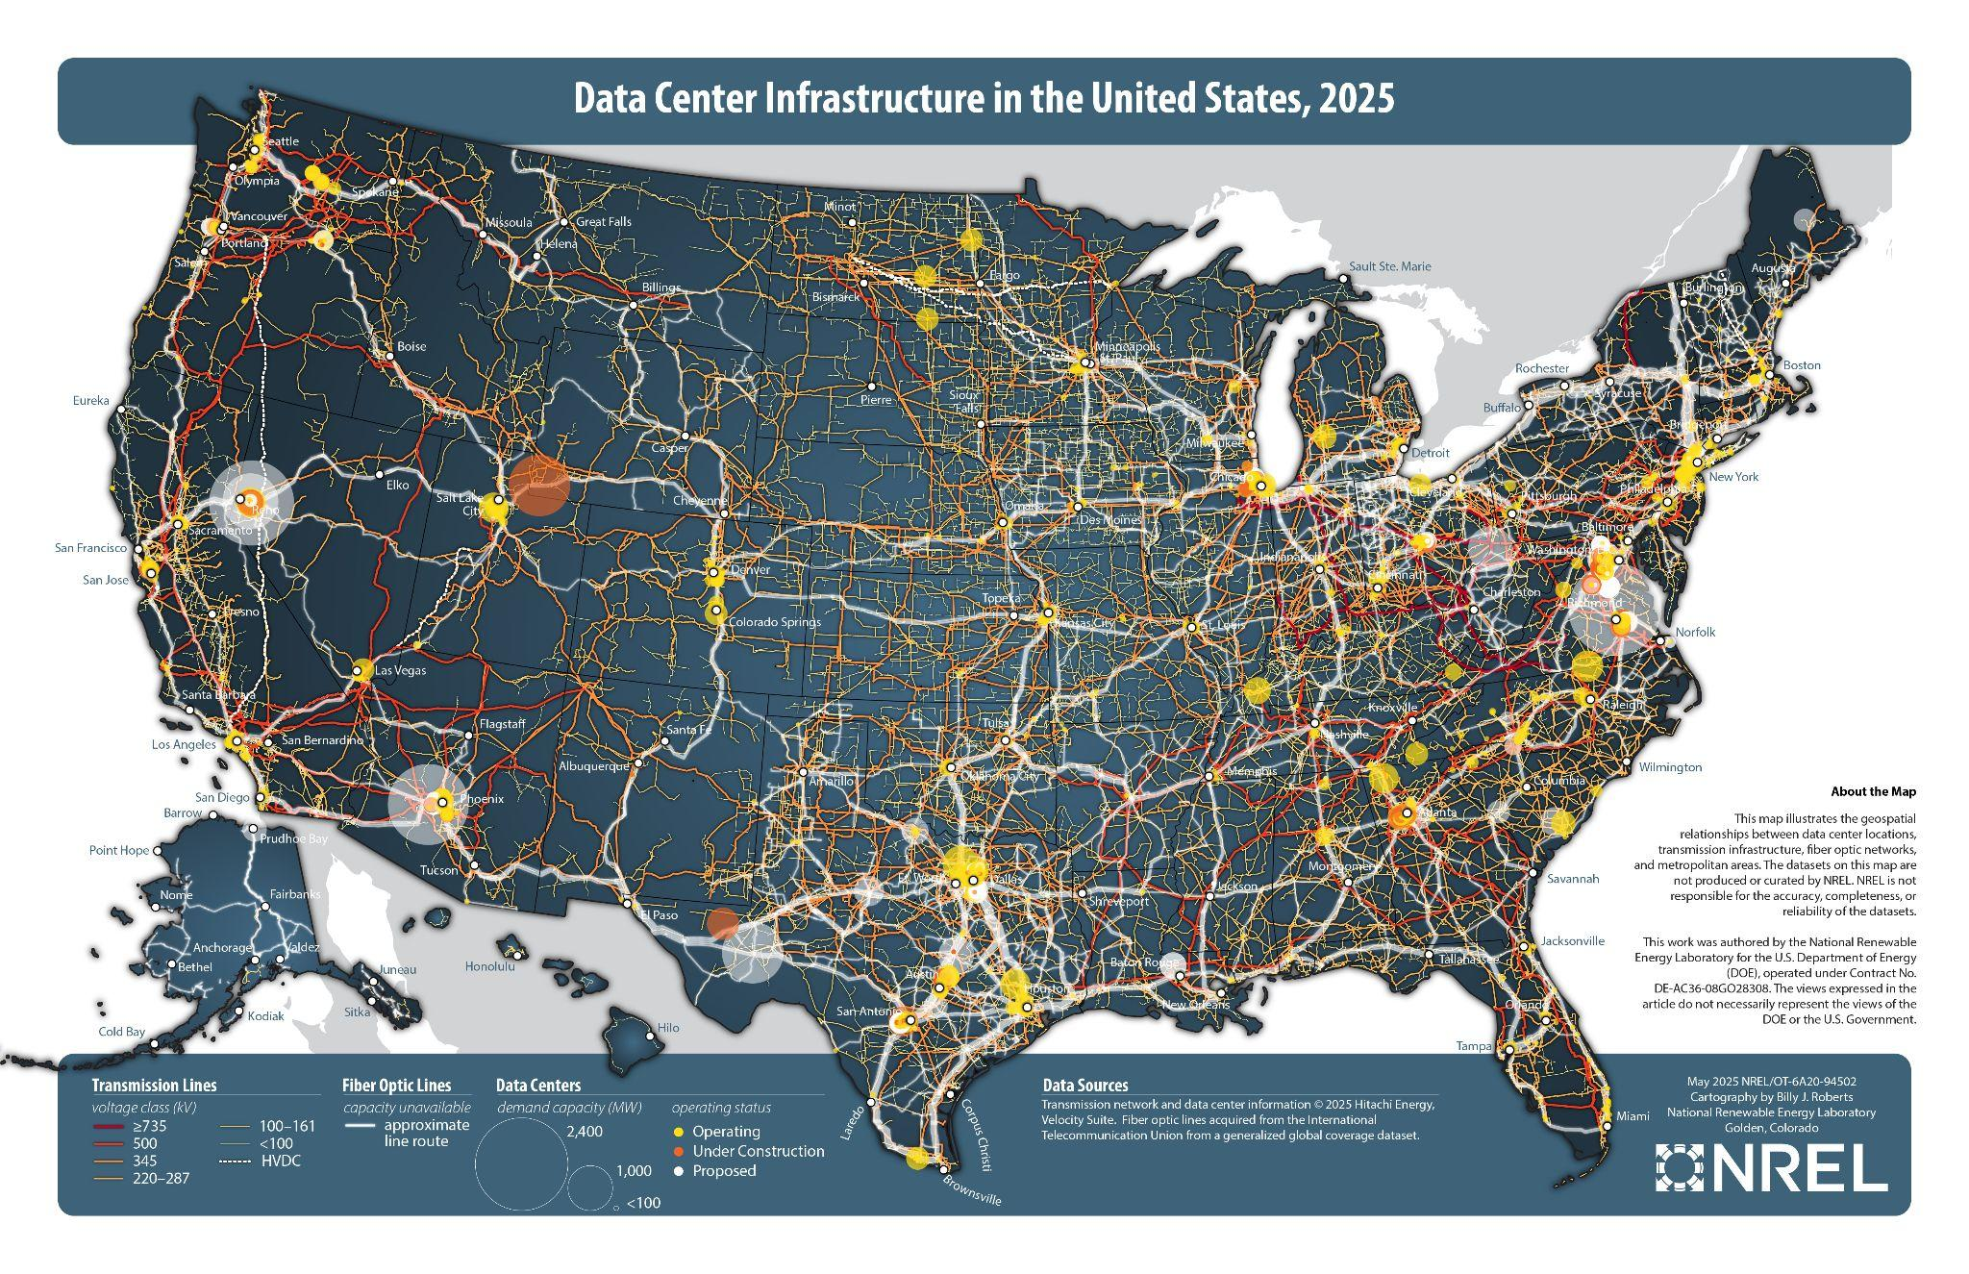
Infrastructure Considerations
Roberts, B. (2025). Data Center Infrastructure in the United States, 2025.

Slide 12
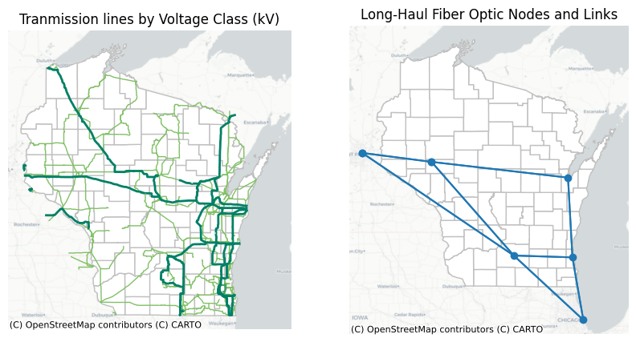
Transmission and Fiber Infrastructure in Wisconsin
Communities near existing high voltage transmission lines will be attractive to data center developers.
Data source: .U.S. Fish and Wildlife Service, US Electric Power Transmission Lines; Durairajan, Ramakrishnan, et al. "InterTubes: A study of the US long-haul fiber-optic infrastructure." Proceedings of the 2015 ACM conference on special interest group on data communication. 2015.

Slide 13
Near-Future WI Data Centers Energy Needs
Project | Power (MW) | Status
Beaver Dam - Meta | 400 | Under Construction
Port Washington - Vantage | 1,300 | Under Construction
Mt Pleasant Campus - Microsoft | 2,000 | Under Construction
Turtle & Beloit, Wisconsin Rapids | 500 | Planned
That’s almost 4,500 MW of power that doesn’t currently exist on the grid.
Generating 5,000 MW of solar energy generation would require 25,000 MW solar capacity and ~100,000 acres.¹
¹M. Bolinger, M. and G. Bolinger (2022). Land Requirements for Utility-Scale PV: An Empirical Update on Power and Energy Density; ²2025 Wis. A.B. 840.

Slide 14
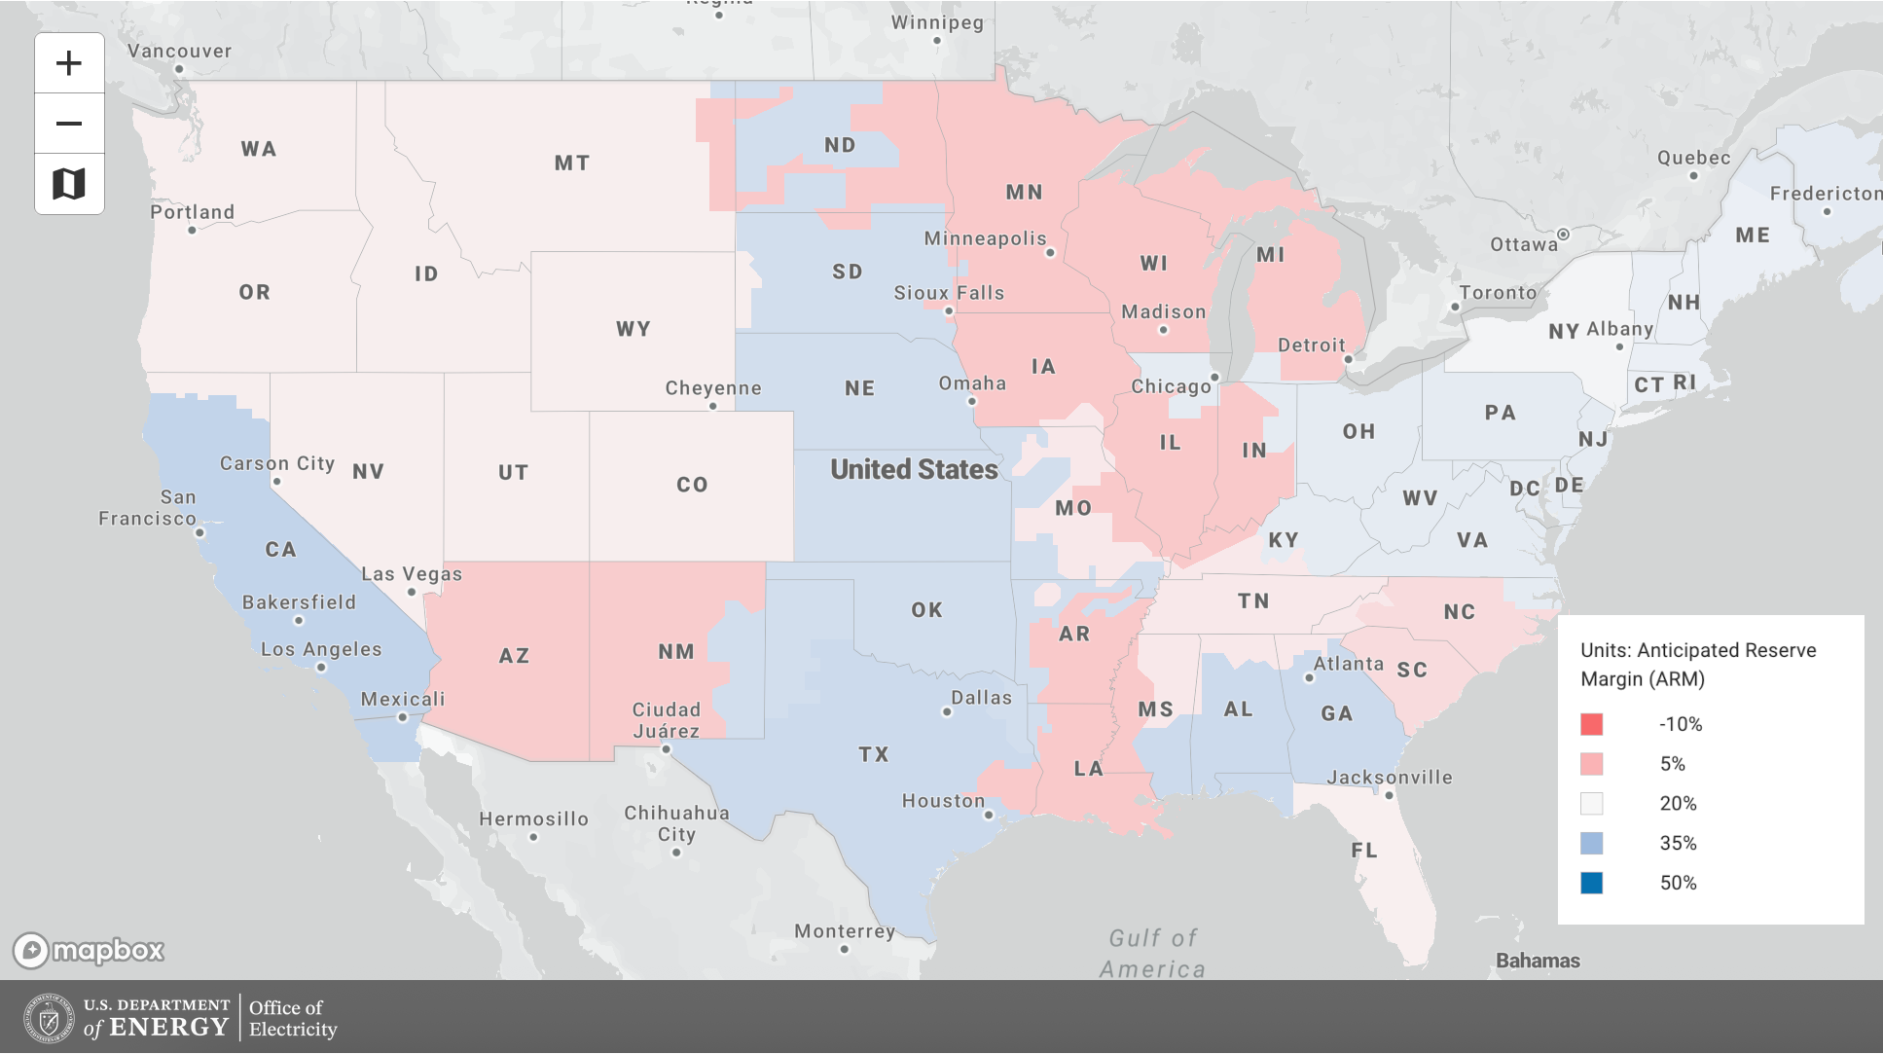
Estimated 2030 Energy Reserve Margins
Midwest ISO
U.S. Department of Energy, Accelerating Speed to Power, Data Viewer.

Slide 15
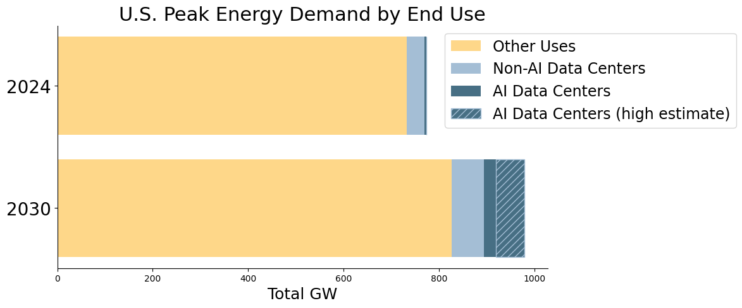
Estimated U.S. Energy Demand by End Use
Compound Annual Growth rate in power demand over the last decade has been 0%.
Haensch (2026), Estimated U.S. Energy Capacity by End Use; Goldman Sachs (2024) AI, data centers and the coming US power demand surge.

Slide 16


Data Centers will Improve the Grid but Might Raise Costs
Regional Transmission Organization
Midwest ISO (MISO) oversees wholesale energy markets, regulated by Federal Energy Regulatory Commission (FERC).
WI Public Service Commission
Regulatory Agency that must approve any proposed rate changes.
Residential Ratepayers
Pay monthly fees based on kWh used, plus a connectivity fee, and small upcharge for grid maintenance and improvement.
Commercial Ratepayers
Pay more complicated monthly fees based on e.g. kWh used, on/off peak designation, plus a facilities charge for grid maintenance and improvement.
Energy Generators
Power plants, solar farms, wind farms
Investor Owned Utilities
Alliant Energy, WE Energies, Madison Gas and Electric
Data Centers
Separate rate class that pays more for necessary grid improvements.
= pays money to
= Ad hoc approval by PSC on April 25, 2026

Slide 17
Ratepayer Protections and Large Load Tariffs
Current Ad hoc utility/project specific solutions:
  Alliant service agreement in Beaver Dam.¹
  We Energies Very Large Customer (>500MW) Tariff.²
Include provisions for stranded assets, and require FERC cooperation for transmission buildout.
Possible Statewide framework:
  AB 722, failed to advance ☠️.
Key Provisions: Required wage rates, data center energy rate class, renewable resource tariff and reporting.
  AB 840, passed Assembly ☠️.
Key Provisions: Ensure ratepayer protection, colocation of renewables, closed-loop (or similarly water-intensive) cooling, water use disclosures, reclamation bond, land restoration for canceled projects.
*
¹Wisconsin Public Service Commission, PSC Ensures Stronger Public Transparency, Customer Protections in Review of Alliant Energy’s Data Center Service Agreement; ²The Public Service Commission of Wisconsin, PSC Overhauls We Energies’ Data Center Tariff, Makes Improvements to Protect Existing Customers;

Slide 18
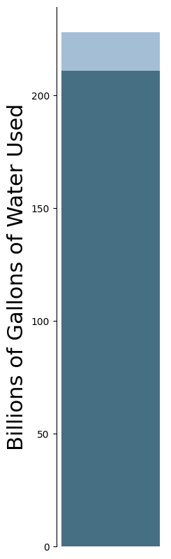
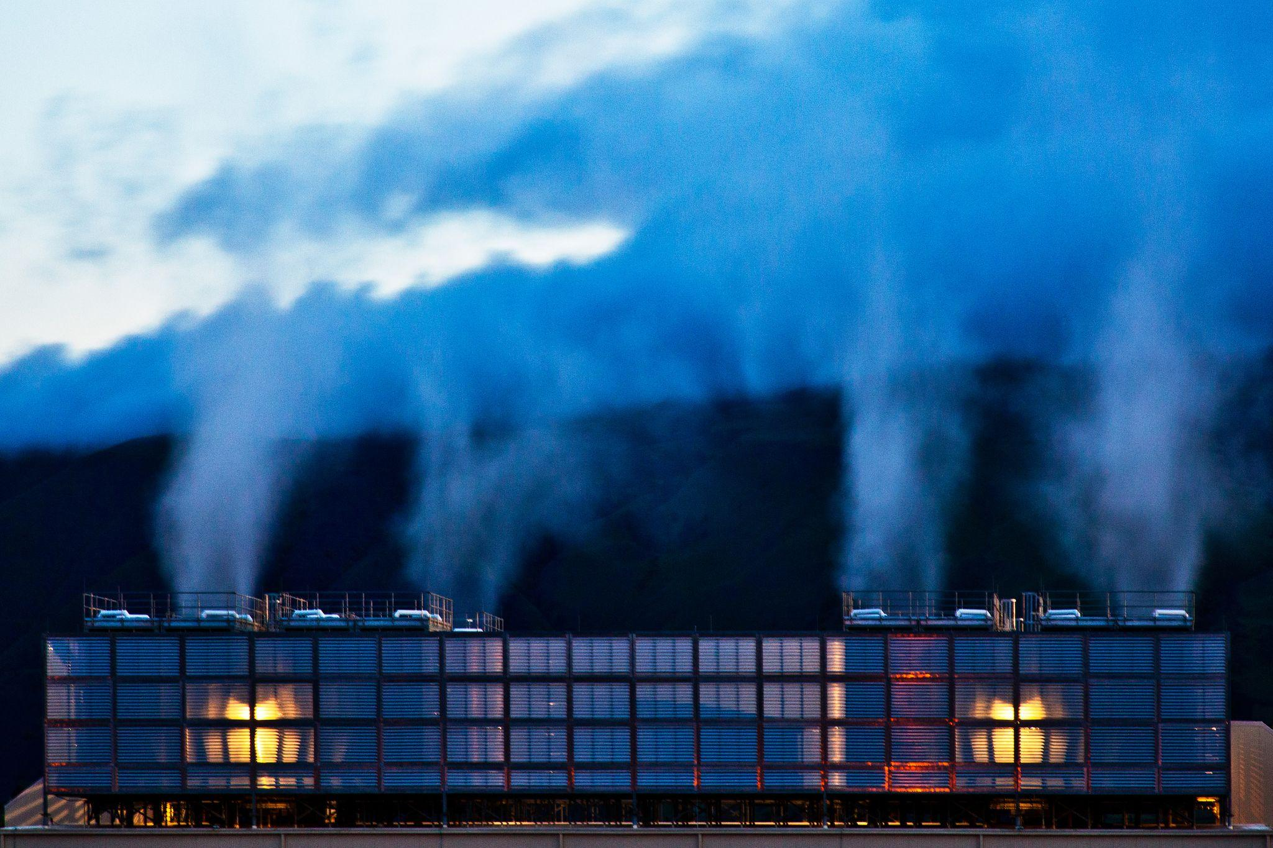




Cooling at Scale
211 billion gallons of indirect water used for power generation.
17 billion gallons of direct water used for cooling.
Power Plant
Chiller/Heat
Exchanger
Data Center
Server Room
Cooling Towers
Cooling Tower
Fresh Water
Shehabi et al (2024). 2024 United States Data Center Energy Usage Report.

Slide 19
3. Economic Impacts and Policies

Slide 20
Wisconsin Data center Sales and Use Tax Exemption Program
Created by 2023 Wisconsin Act 19, aims to bolster economic growth and attract high tech industries and talent.
Developers are exempt from sales and use tax for tangible property.
e.g. computer server equipment, networking equipment, and other essential hardware.
For a hyperscale data center replacing it’s equipment every 3-4 years, this will amount to billions of dollars in foregone tax revenue over a data center lifetime.
2023 Wisconsin Act 19 - Data Center Sales and Use Tax Exemption (DCSTE) Program; Wisconsin Watch, Wisconsin Data Center Tax Break to Cost State More Than $2 billon.

Slide 21
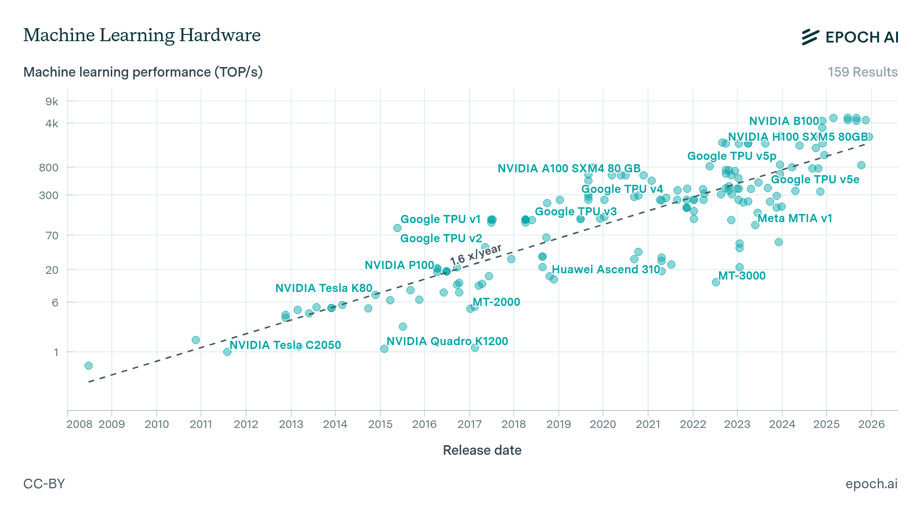
AI Hardware Keeps Improving
Trillions of operations per second
NVIDIA Blackwell
Epoch AI (2025). Data on Machine Learning Hardware.

Slide 22
Risks Associated with Obsolescence
Building and Infrastructure Design Life 15-25 years
Building shell
Power delivery infrastructure
Cooling units, water pipes, and chillers
Computing Equipment Design Life 3-5 years
Servers, CPUs, and GPUs
UPS batteries
Networking gear
Also consider the pace of technology innovation, denser storage, more efficient software, more powerful GPUs
…But beware Jevon’s Paradox!

Slide 23
Jobs
Northern Virginia 570 data centers | 14,240 jobs | 12,124 jobs 3.5x multiplier in secondary sectors
Thats ~20 jobs per data center.
According to Microsoft:
“…generally we employ 50 full time and vendors per building.”¹
¹Northern Virginia Technology Council (2024). Virginia Data Center Report; ²Data Center Maps, Virginia Data Centers

Slide 24
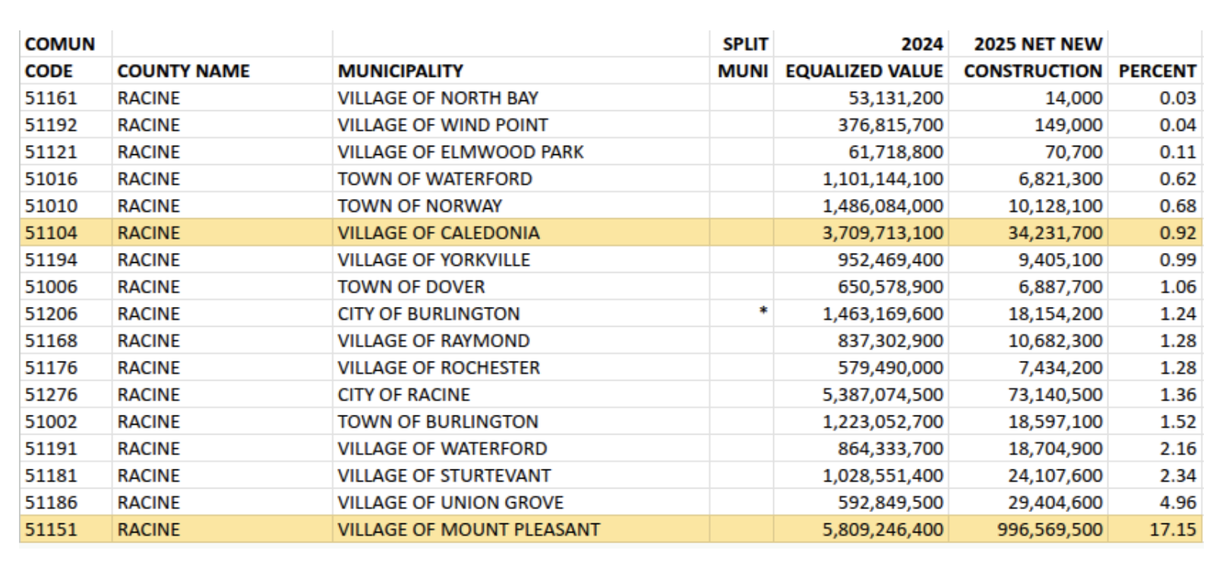
Net New Construction
This Development Comes with Benefits and Risks: Net New Construction allows increased tax levies, but concentrates risk in a single ratepayer and might act as a boat anchor to future growth.
Wis. Stat. § 66.0602 (2023-24), Local Levy LImits; 2023 Data Centers in Wisconsin - The Perfect Storm of Incentives.

Slide 25


Tax Increment Financing
Port Washington Referendum in April 2026 requires vote on any TIF above $10 million.
START
Your city has a small property tax base and you want to make it bigger.
You establish a Tax Increment District with plans to build.
A base assessed property value in the TID is registered.
Improvements attract developers who add net new construction and increment the tax rate above base.
You borrow from your future tax revenue to fund site improvements in the TID.
Your city has a large property tax base.
You spend the next 20 - 30 years paying back this debt.
¹Wisconsin Department of Revenue (R. 11-25) Tax Incremental Financing Manual; ²Port Washington (2025), Frequently Asked Questions; ³Wis. Stat. § 66.0602 (2023-24),

Slide 26
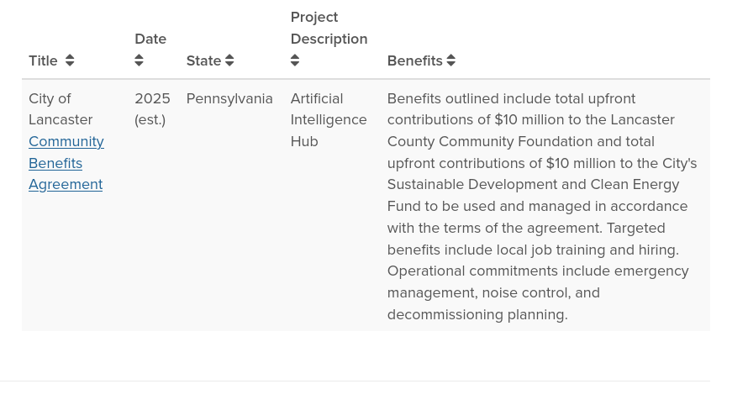
Community Benefit Agreements
Formal Community Benefit Agreements are signed by developers, local governments, and/or community organizations. They can include things like:
Community benefit funds or direct payment
Job training and prioritized local hiring
Economic development programs
Construction agreements (off-season, daytime)
Local land rehabilitation and greening
Ratepayer utility relief mechanisms
Example of a Negotiated CBA.
Local processes typically enlist community members, staff, facilitators, technical experts, lawyers.
Columbia Law School (2026). Community Benefits Agreements Database; U.S. Department of Energy, Wind Energy Community Benefits Guide.

Slide 27
3. Federal Policy

Slide 28
Federal Legislation and Executive Actions
Trump Executive Order 14318 on Accelerating Federal Permitting of Data Center Infrastructure¹
Key Provisions: Facilitate rapid data center buildout on appropriate Federal land, fast-tracks environmental review.
H.R. 5927 - Securing Reliable Power for Advanced Technologies Act²
Key Provisions: Designates certain energy projects as “priority national defense” with expedited permitting and environmental review.
S. 1475 - Clean Cloud Act of 2025³
Key Provisions: Establishes emissions standards, data collection, and zero-carbon goals for cloud computing facilities.
S. 3585 - DATA Act of 2026⁴
Key Provisions: Exempts off-grid power suppliers form Federal Power Act
S. 4214 - AI Data Center Moratorium⁵
Key Provisions: impose a moratorium on the construction of new data centers until legislation is enacted that safeguards the public from the dangers of artificial intelligence
¹E.O. 14141 Revoked by E.O. 14318; ²H.R. 5927; ³S. 1475; ⁴S. 3585; ⁵S. 4214

Slide 29
Anna Haensch
anna.haensch@wisc.edu

Slide 30
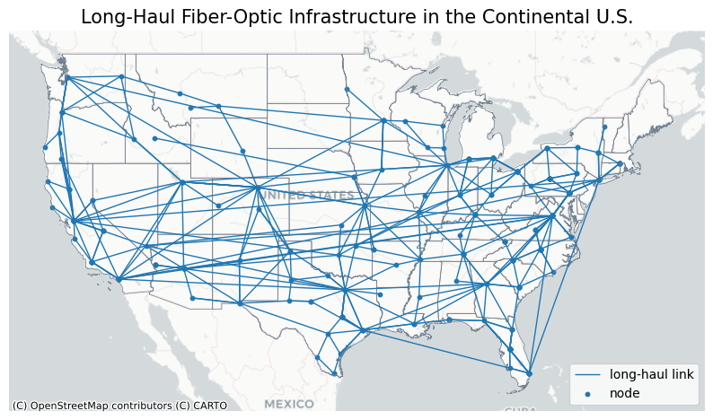
U.S. Long-Haul Fiber-Optic Infrastructure
Haensch (2026). U.S. Long-Haul Fiber-Optic Infrastructure;. Data source: R. Durairajan et al. (2015) Intertubes: A study of the us long-haul fiber-optic infrastructure, in: Proceedings of the 2015 ACM conference on special interest group on data communication. Github.

Slide 31
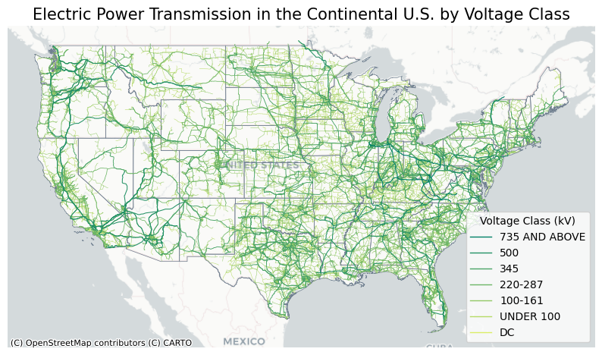
U.S. Grid and Transmission Infrastructure
Haensch (2026). U.S. Grid and Transmission Infrastructure; Data source: Homeland Infrastructure Foundation-Level Data obtained via U.S. Fish and Wildlife, US Electric Power Transmission Lines.

